Slide 1

Transportation Flow Control
Team Godzilla
December 13, 2014

Slide 2
AGENDA
Introduction and Statement of Problem
Approach
Results
Exploratory and Deductive
Modeled
Discussion

Slide 3
Introduction and Statement of Problem

Slide 4


Slide 5


Slide 6


Slide 7
Approach

Slide 8


Slide 9
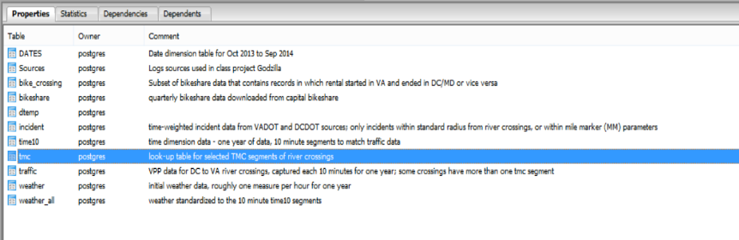
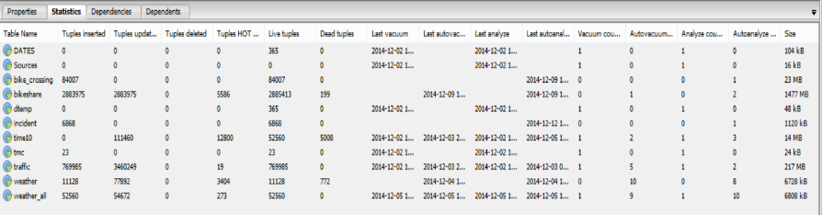
PostgreSQL used to standardize data and create datasets for further analyses

Slide 10
Other data collected
Summary data
Capacity of subway crossings
Overall bicycle capacity on crossings
Commuter-adjusted population of Washington, DC
Evacuation plan for DC
Traffic density data
Collected from 2 days of 15-minute segments of data on 14th Street Bridge (I-395) river crossing
Used to drive overall traffic flow model (van Aerde)
Used speed sensor data as surrogate for flow in most analyses

Slide 11
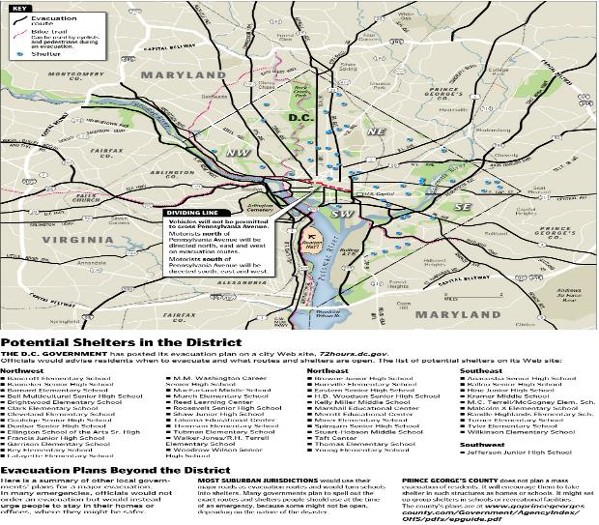
Generalized DC Evacuation Plan

Slide 12


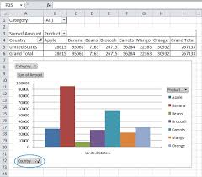

Exploration of data
Visualization tools
Statistical exploration with R

Slide 13
Results
Exploratory and Deductive

Slide 14
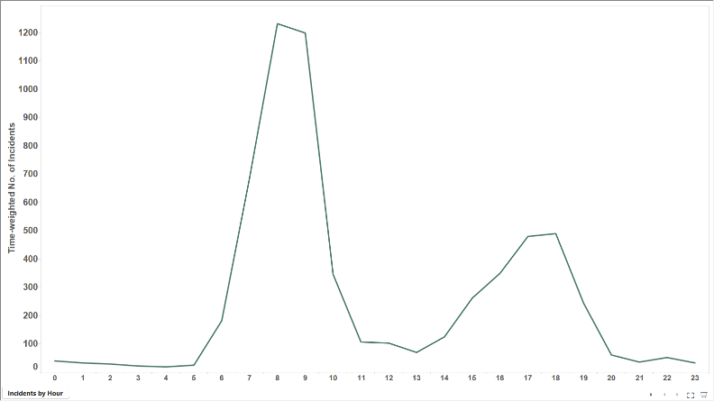
Explore: Incidents by Hour of Weekday

Slide 15
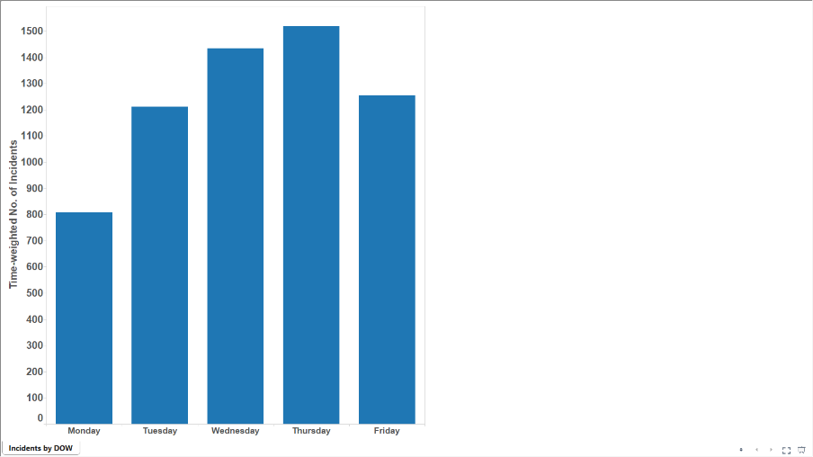
Explore: Incidents by Day of Week

Slide 16
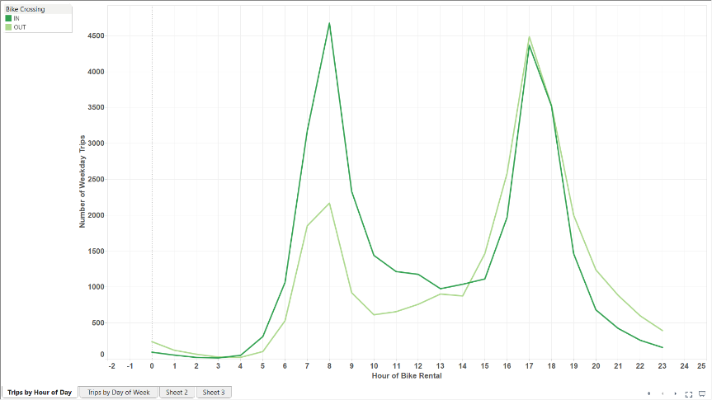
Explore: Bikes by hour (Weekday)

Slide 17
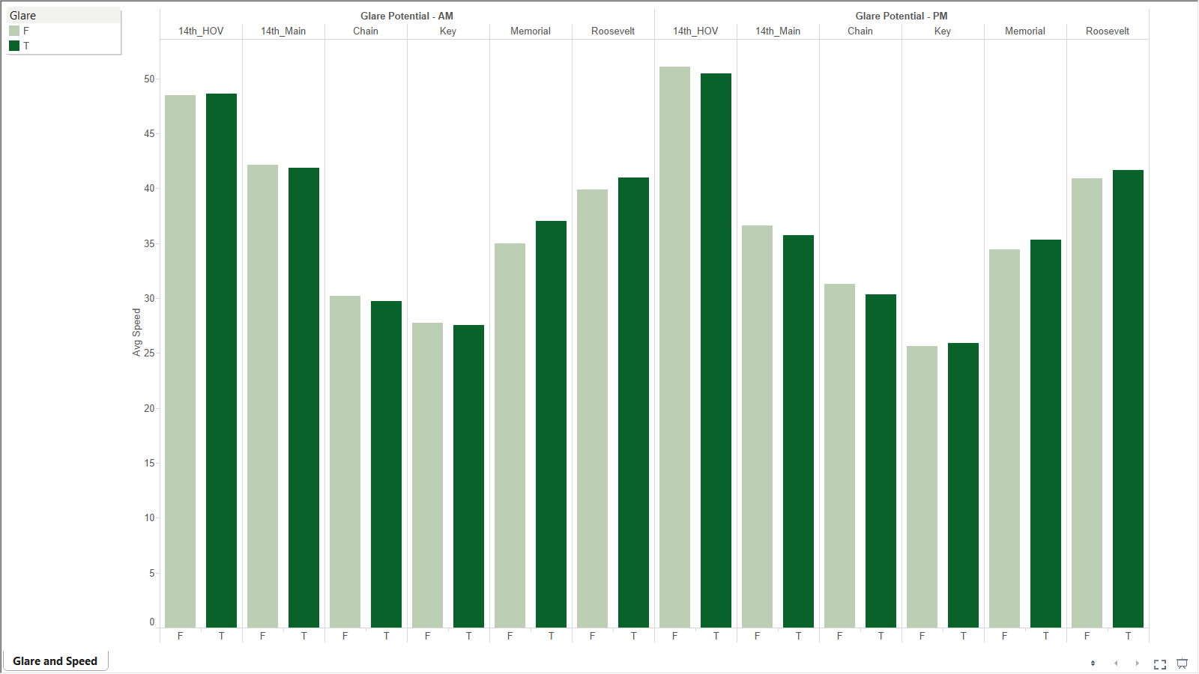
Explore: Glare

Slide 18
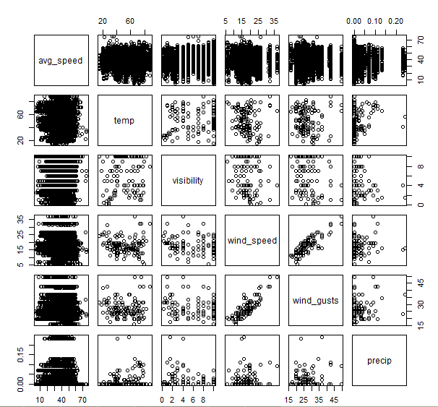
Explore: Scatterplot Matrix

Slide 19
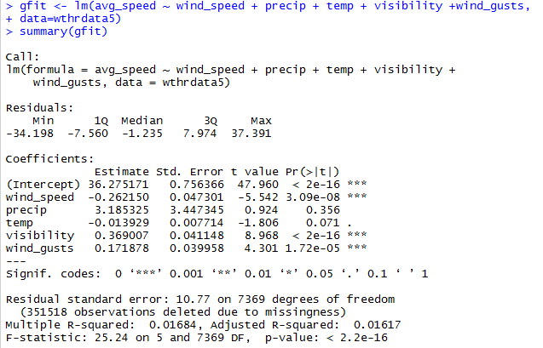
Explore: Regression

Slide 20
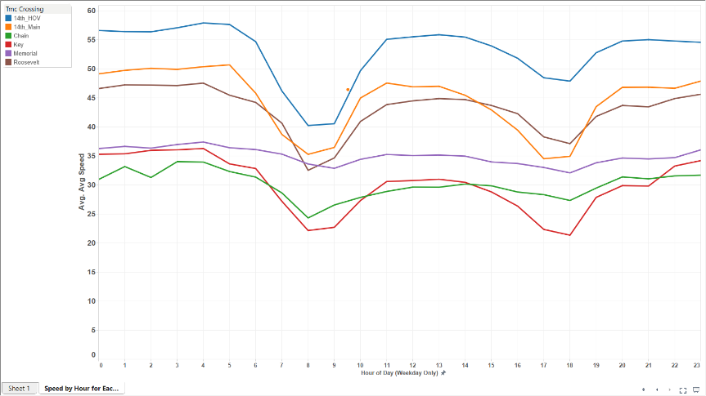
Speed by crossing (Mean)

Slide 21
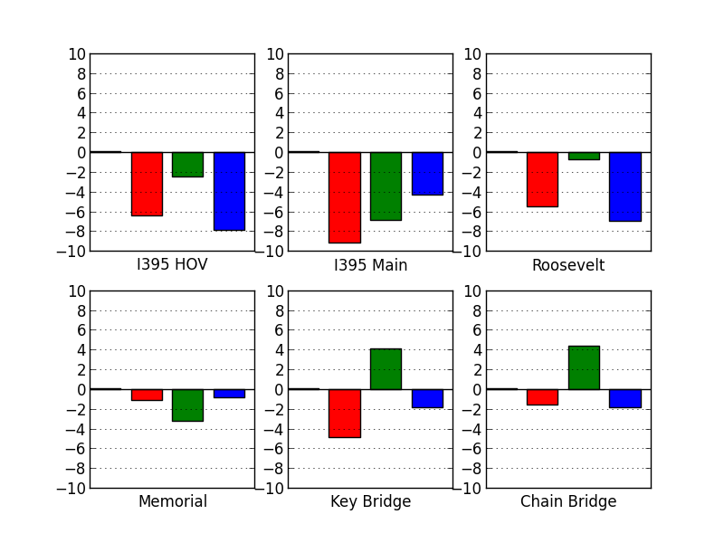
Effect of precipitation on speed
Inbound Bridge Crossings
Bars show percentage change in speed as compared to dry conditions
Light
Heavy
Ice / Snow

Slide 22
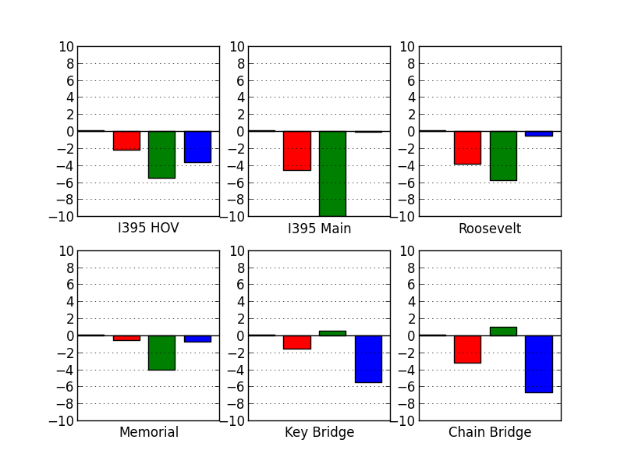
Effect of precipitation on speed
Outbound Bridge Crossings
Bars show percentage change in speed as compared to dry conditions
Light
Heavy
Ice / Snow

Slide 23
Average speed by time of day
I-395 North Mainline
51 free flow speed
40 posted speed limit
Speed (mph)
31 rush hour average
00:00
6:30
10:30
15:00
19:00
23:59
Time of Day

Slide 24
Results
Modeled

Slide 25
Modeling traffic flows
Historically, hydrodynamic models have been applied to macroscopic traffic flow modeling
“Human component” (vehicle drivers) is a complicating factor – creates behaviors inconsistent with the pure flow models
Since data are available, researchers are able to use curve-fitting models
Based on the most basic fluid dynamic relationship:
Traffic engineering literature suggests this class of model prevails in operational contexts, though there are many variations
Flow = Density x Speed

Slide 26
The Van Aerde model (1995) is chosen
Model fully described by a four parameter input vector:
Flow (Q)
q_{c}
u_{f} – Free flow speed
u_{c} – Speed at maximum flow (capacity)
q_{c} – Maximum flow
k_{j} – Jam density
Density (K)
Speed (U)
Speed (U)
u_{f}
u_{c}
Density (K)
k_{j}
Flow (Q)

Slide 27
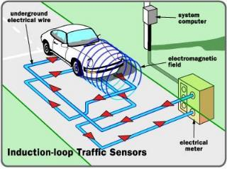
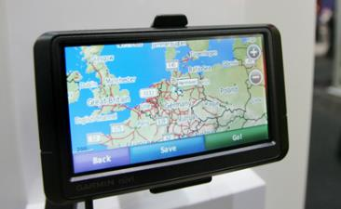
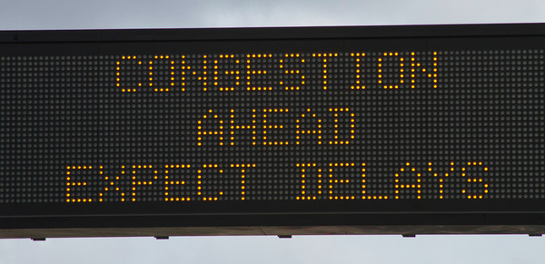

Technology options for speed data
Infrastructure-based
Probe-based

Slide 28
Obtaining the model parameters
Infrastructure-based
Probe-based
Speed Time-mean speed Space-mean speed
Lane occupancy
Density
No data available
Zone occupancy
Flow by lane
Flow
No data available
Flow by zone
Selected parameters

Slide 29
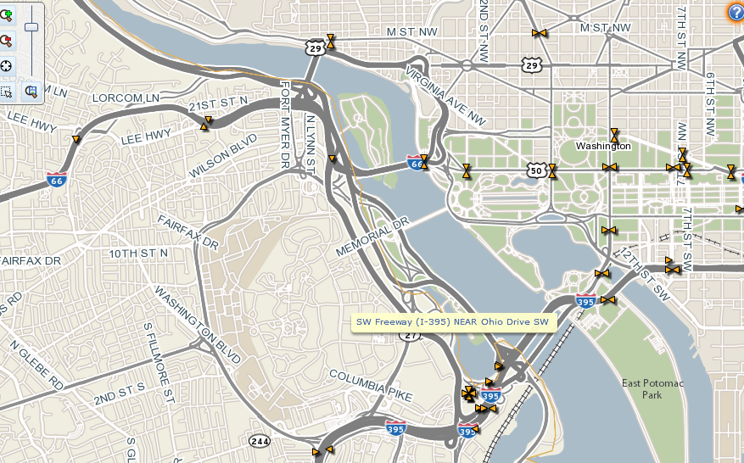
Meet Detector #3490

Slide 30
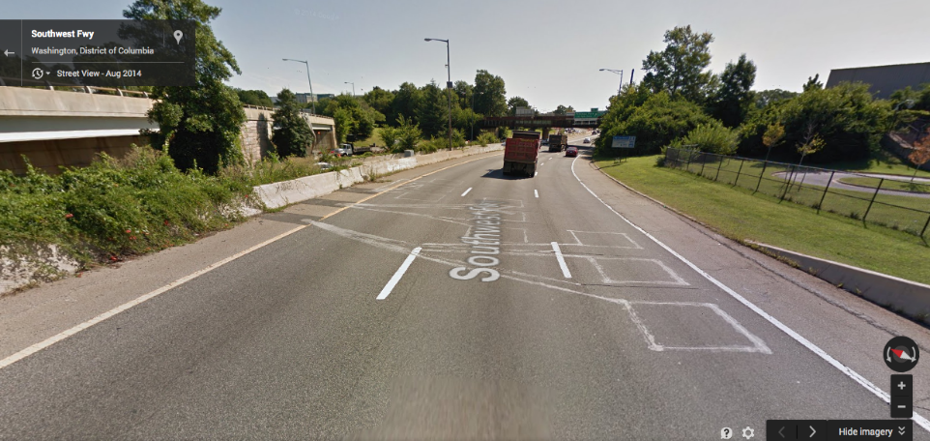
Meet Detector #3490
Source: Google Maps 3D earth view

Slide 31
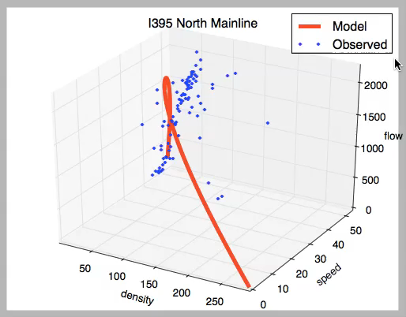
Modeling I395 north mainline crossing
Model is built (and shown here) per traffic lane. This crossing has four lanes.

Slide 32
Using the model: sensitivity to conditions
I395 North Mainline
Modeled Condition | u_{f} | u_{c} | q_{c} | k_{j}
No precipitation * | 51 | 26 | 2083 | 287
Precipitation ** | 47 | 22 | 1773 | 263
Miles/hr
Miles/hr
Veh/hr
Veh/mi
* Modeled parameter vector is based on empirical data put through the ‘data pipeline’.
** Empirical data were unavailable to estimate model. So estimated u_{f} based on available probe data, and other parameters from published model results.
Model is built (and shown here) per traffic lane. This crossing has four lanes.

Slide 33
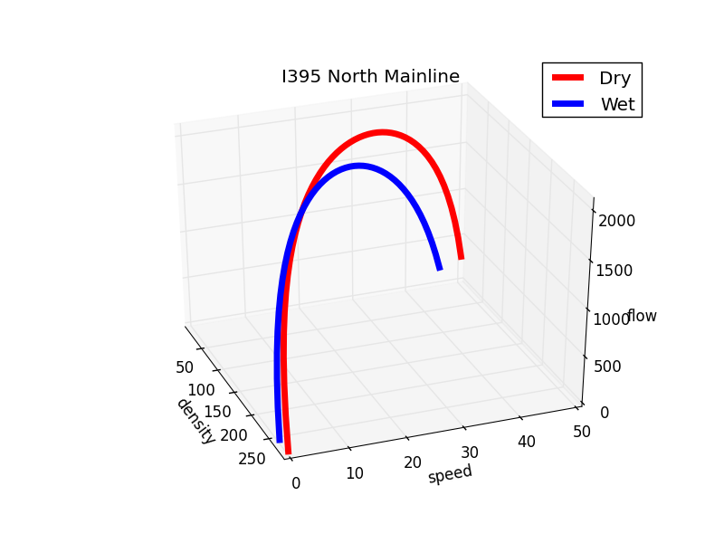
Model allows us to understand crossing capacity as a function of external conditions

Slide 34
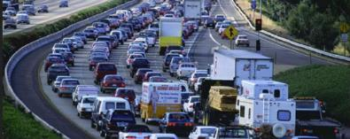
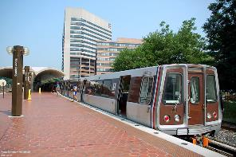
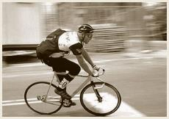
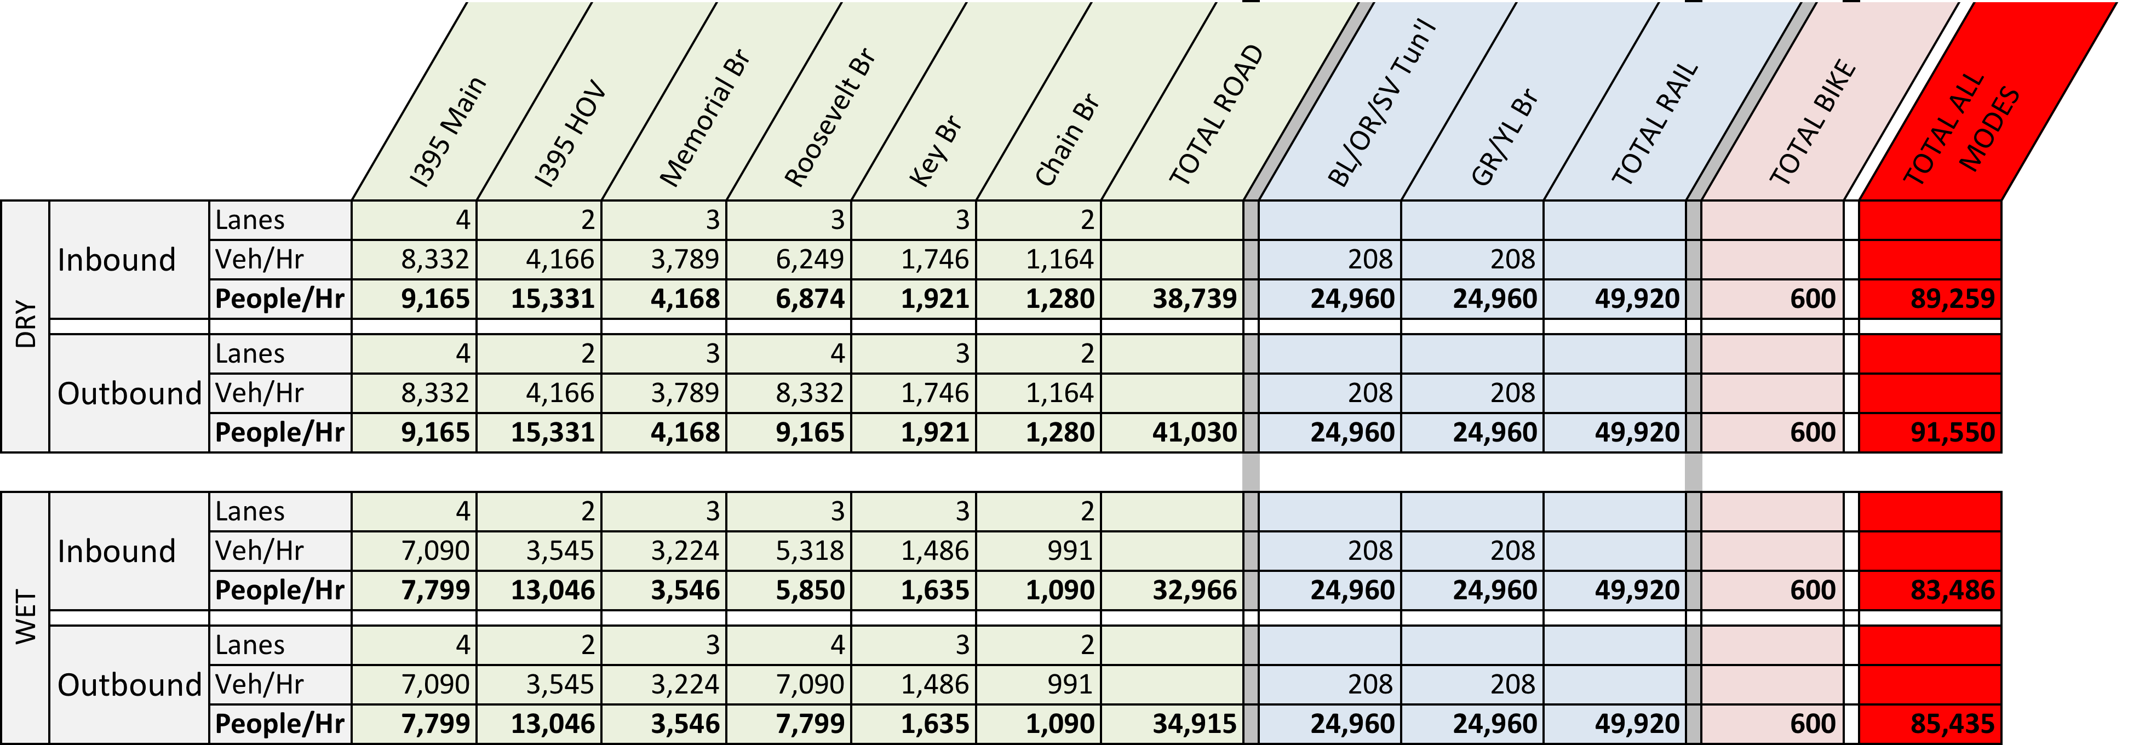
Multimodal capacity between VA and DC
ROAD
RAIL
BIKE

Slide 35
Discussion

Slide 36
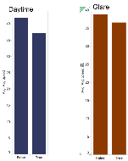
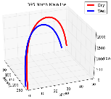
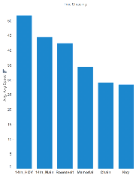
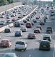
Creating a “data product”
Data Science Maturity Progression
Describe
Predict
Prescribe
Weather
Sun Glare
Modeled Performance of Bridge Crossings
Control Algorithm to Maximize Flow
Traffic Incidents
Day-specific
(day of week, holiday, gov’t status)

Slide 37
Dimensions of control schemes
Personal
Augmented “real-time” routing (e.g., smartphone app)
?
M2M- Focused Personal mobility
Span of Control
Road Authority Flow Control
“Black Swan”
Centralized
Daily
?
Operational
Today
~ 2030’s
Planning

Slide 38

Summary

